Slide 1
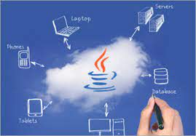
What Is Java? A Beginner’s Guide to Java and Its Evolution
Created and Published By : - Girish Rathode

Slide 2
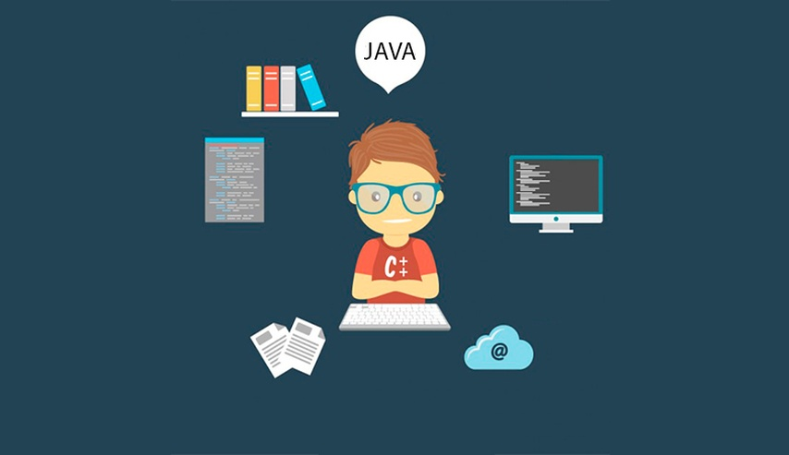
Contents
What is Java?
History of Java
What is Java used for?
Features of Java
Components in Java

Slide 3
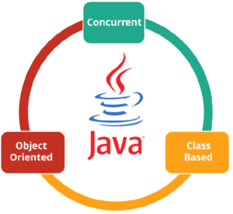
What Is Java?
Java is a general-purpose, concurrent, object-oriented, class-based, and the runtime environment (JRE) which consists of JVM which is the cornerstone of the Java platform.

Slide 4
History of Java
Java is a programming language developed by James Gosling with other team members named Mike Sheridan and Patrick Naughton also called as Green Team in 1995 for Sun Microsystems for digital devices such as set-top boxes, televisions etc.

Slide 5
What is Java used for?
Before I answer the question, what is Java used for, let me brief you about why you should choose Java.
Java is highly popular and has dominated this field from early 2000’s till the present 2018.

Slide 6
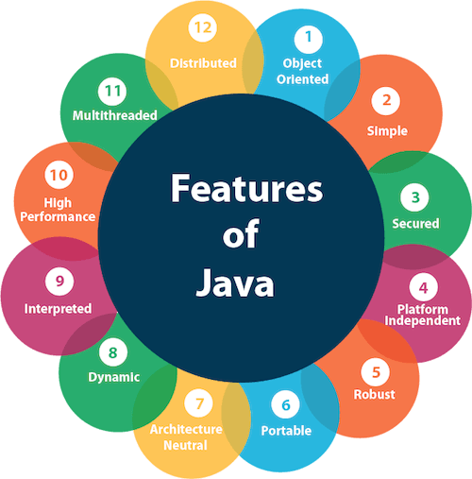
What is Java used for? Contd…
Java has been used in different domains. Some of them are listed below:
Banking: To deal with transaction management.
Retail: Billing applications that you see in a store/restaurant are completely written in Java.
Information Technology: Java is designed to solve implementation dependencies.
Android: Applications are either written in Java or use Java API.
Financial services: It is used in server-side applications.
Stock market: To write algorithms as to which company they should invest in.
Big Data: Hadoop MapReduce framework is written using Java.
Scientific and Research Community: To deal with huge amount of data.

Slide 7
Features of Java
Simple: Java has made life easier by removing all the complexities such as pointers, operator overloading as you see in C++ or any other programming language.
Portable: Java is platform independent which means that any application written on one platform can be easily ported to another platform.
Object-oriented: Everything is considered to be an “object” which possess some state, behavior and all the operations are performed using these objects.
Secured: All the code is converted in bytecode after compilation, which is not readable by a human. and java does not use an explicit pointer and run the programs inside the sandbox to prevent any activities from Untrusted sources. It enables to develop virus-free, tamper-free systems/applications.
Dynamic: It has the ability to adapt to an evolving environment which supports dynamic memory allocation due to which memory wastage is reduced and performance of the application is increased.

Slide 8
Features of Java
Distributed: Java provides a feature which helps to create distributed applications. Using Remote Method Invocation (RMI), a program can invoke a method of another program across a network and get the output. You can access files by calling the methods from any machine on the internet.
Robust: Java has a strong memory management system. It helps in eliminating error as it checks the code during compile and runtime.
High Performance: Java achieves high performance through the use of bytecode which can be easily translated into native machine code. With the use of JIT (Just-In-Time) compilers, Java enables high performance.
Interpreted: Java is compiled to bytecodes, which are interpreted by a Java run-time environment.
Multithreaded: Java supports multiple threads of execution (lightweight processes), including a set of synchronization primitives. This makes programming with threads much easier.

Slide 9
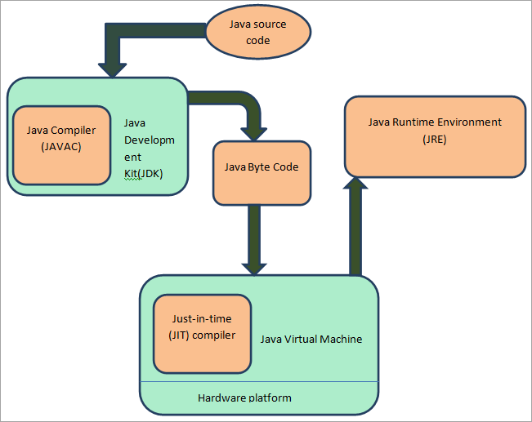
Components in Java

Slide 10
Components in Java
JVM (Java Virtual Machine)
It is an abstract machine. It is a specification that provides a run-time environment in which Java bytecode can be executed. It follows three notations:
Specification: It is a document that describes the implementation of the Java virtual machine. It is provided by Sun and other companies.
Implementation: It is a program that meets the requirements of JVM specification.
Runtime Instance: An instance of JVM is created whenever you write a java command on the command prompt and run the class

Slide 11
Components in Java
JRE (Java Runtime Environment)
JRE refers to a runtime environment in which Java bytecode can be executed.
It implements the JVM (Java Virtual Machine) and provides all the class libraries and other support files that JVM uses at runtime.
So JRE is a software package that contains what is required to run a Java program.
Basically, it’s an implementation of the JVM which physically exists.

Slide 12
Components in Java
JDK(Java Development Kit)
It is the tool necessary to:-
Compile
Document
Package Java programs.
The JDK completely includes JRE which contains tools for Java programmers.
The Java Development Kit is provided free of charge.
Along with JRE, it includes an interpreter/loader, a compiler (javac), an archiver (jar), a documentation generator (Javadoc) and other tools needed in Java development.
In short, it contains JRE + development tools.

Slide 13
Components in Java
JIT (Just in time )
It Converts .class to binary Format.
It does Following…
1.Reads code line by line.
2.Excutes code Line by line
3.Translate from .class to binary.

Slide 14
Components in Java
RTE (Runtime Error / Exception )
It’s a java program will execute line by line from left to right.

Slide 15
Hello World Program
First of all, I will give you a simple overview of how a Java program looks like. In the below code,.
I have created a class – MyFirstJavaProgram and printed “Hello World”.
Go ahead and try to execute the below example in your Eclipse IDE.
Do not worry, we will discuss about Java class in a while.

Slide 16
Hello World Program
public class MyFirstJavaProgram
{
public static void main(String[] args)
{
System.out.println("Hello World");
}
}

